Slide 1
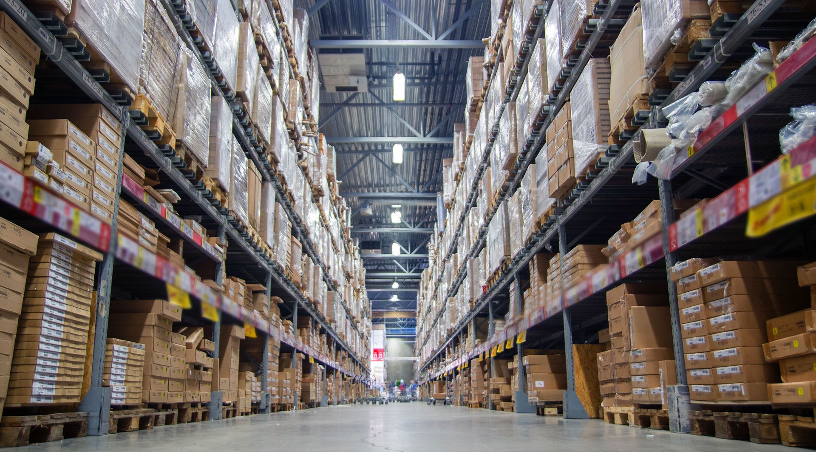
INDIAN INSTITUTE OF INFORMATION TECHNOLOGY
BTP EVALUATION -1
Logistics Website
using Nodejs as Server End
BY
ANIKET DEWANGAN
111716006 ECE
Supervisor :
Dr. Bhupendra Singh

Slide 2
1. Introduction
2. Literature Survey
3. Research Gaps
4. Objectives
5. Methodology
6. Progress
7. Conclusion
8. References
OUTLINE

Slide 3
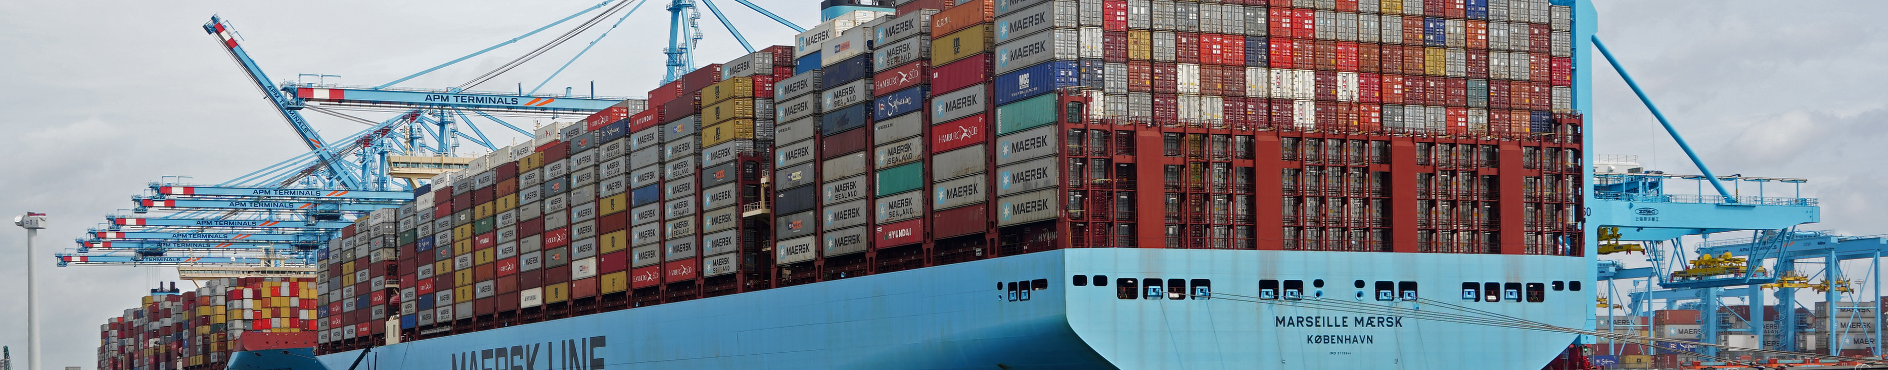
INTRODUCTION
Logistics is used more broadly to refer to the process of coordinating and moving resources – people, materials, inventory, and equipment – from one location to storage at the desired destination. The term logistics originated in the military, referring to the movement of equipment and supplies to troops in the field.
In present World scenario, online deliveries plays a crucial role in connecting all the business from big to small and the logistics companies are playing a great role in maintain this balance .
This website tries to connect people of the lower tier as well as the individuals We render our expertise in door to door ,imparting Rapid, Cost effective, Reliable and Time-definite delivery of parcels across different locations all over India.

Slide 4
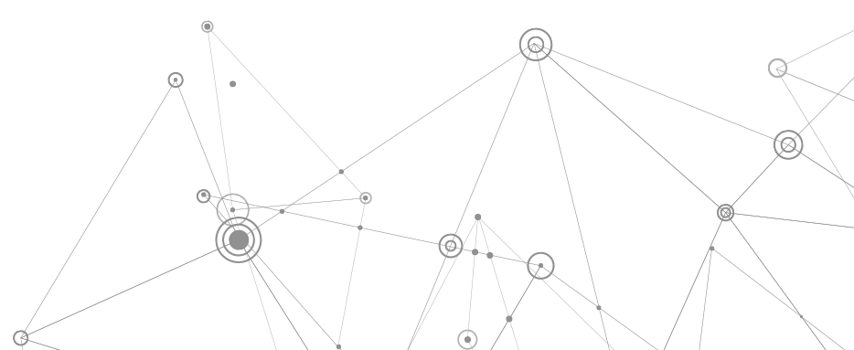
Literature survey
Literature Survey

Slide 5
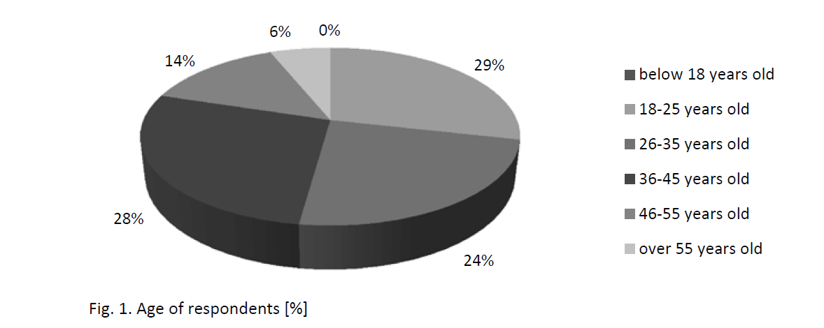
Literature Survey
Literature Survey
Recently, the courier, express and parcel market (CEP) has developed dynamically worldwide. For example, in Poland, in the period 2000–2015, the number of registered courier operators increased by 1400%, while the volume of deliveries and revenue grew at double-digit pace .
^{[5]}Although courier services stand at the juncture of logistics and postal services, they have characteristic features, which differentiate them, for example, the specified delivery time with an accuracy to an hour, money back guarantee, receipt of the shipment, delivery to the addressee in door-to-door system the ability to track the shipment in the tracking-tracing system, the role of specific messenger courier.
^{[5]}Based on the literature overview and
web-sites of courier companies, criteria of
service quality were elaborated:
-> Time of Delivery
-> Service Price
-> flexibility
-> Comprehensive Service
->Trust
-> Modern Technology

Slide 6

Literature Survey
Web Dev TOOLS Used These Days
Web Application Frameworks ^{[2]}
Back End ^{[4]}
DJANGO
ANJULAR
DJANGO
NODEJS
REACT
VUEJS
PHP
Ruby on Rails
Databases
Includes :-
HTML
CSS
JAVASCRIPT ^{[1,3]}
MONGODB
MYSQL
What to use?

Slide 7


NO Effective Door to Door Parcel Deliveries Available.
Sending a Parcel Not so Easy .
RESEARCH
GAPS
Lack of Logistics services for small business and start ups.

Slide 8
To Create a website tailored with the unique needs of the modern logistics.
Starting from the delivery categories to the checkout process , the focus is on the ease and distintive and engaging website that works everywhere
Enlist Options on the Website
To include the google analytics and e-commerce tracking to check which services the customer are preferring the most and expand the websites
Design a Responsive Website
The aim is to build a website that includes all the essential features and its super-handy and easy to work with including the payments and customer security
OBJECTIVES

Slide 9

METHOD
METHODOLOGY

Slide 10


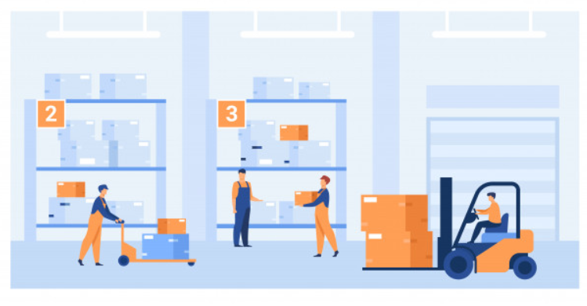
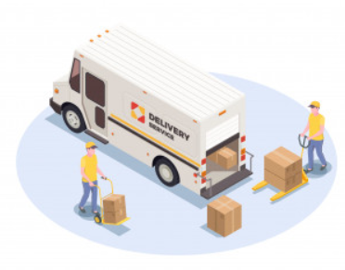
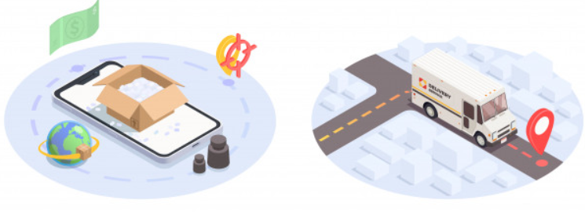
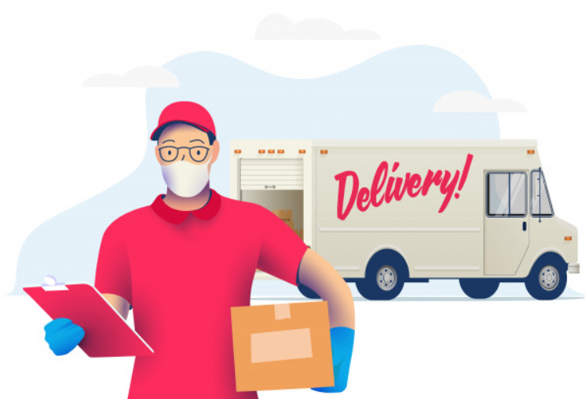
Methodology
How it Works?

Slide 11

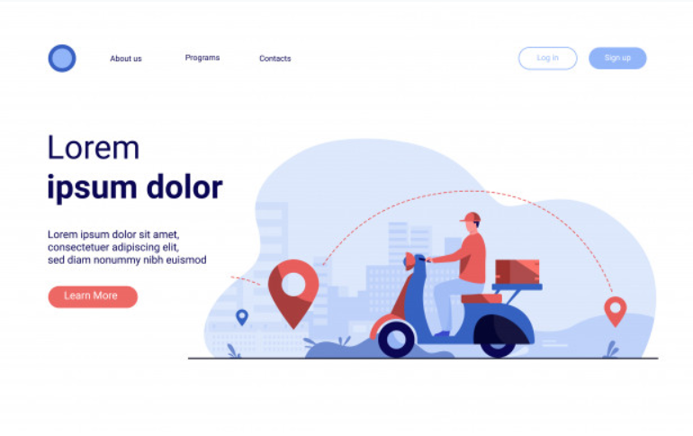
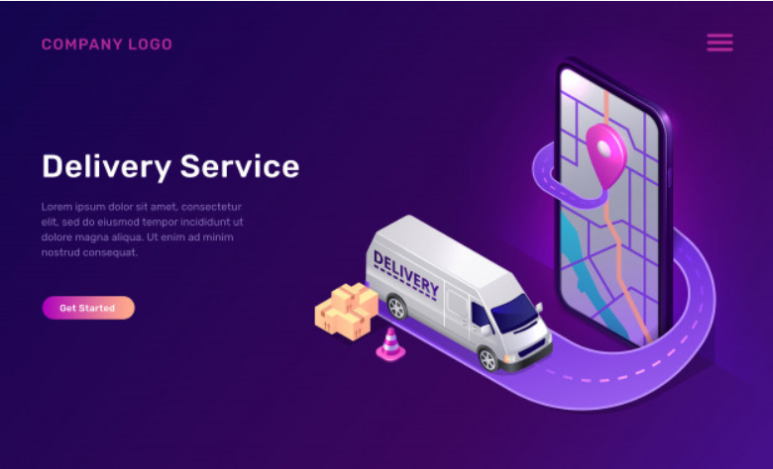
How this Website Works?
Customer Interface Pick Guy Interface Admin Interface
Home
Contact us
Track Feature
Place a Courier option
Manage Order History in
My space
Home
Contact us
Orders Assigned to pick/ deliver
Check Done and pending tasks
Contains records of both interface
Assigns orders to free and near guys
Connects the whole system

Slide 12
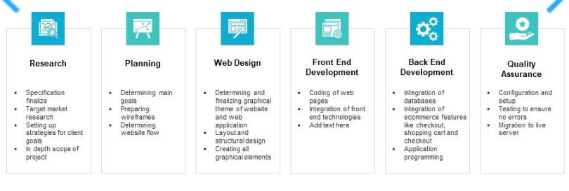
Methodology
How to execute ?

Slide 13

Flow of Website
Home
Track
Instant order
Home
About Us
Contact
Login
Parcel details
Essential details
Payment
Customers
Workers
Admin
Tracking page
Status and details of active orders
Orders
Assigned orders
Total history
Payment
Home

Slide 14







Methodology
Front End Requirements:
HTML
SASS AND CSS
JAVASCRIPT
JQUERY
Hosting Requirements:
Using Heroku App
Google Analytics for analysis
Back End Requirements:
Nodejs
NPM modules
Mongodb
Express

Slide 15
Plan design
How it will operate
what features to add
Target the area of the project
Front End Development
The customer end
The delivery end
The admin end
Back End Development
Creating Database
Creating Http Server
Connecting Payment and security features
Hosting the Site
Using the Heroku App
DONE
PROGRESS
TO DO

Slide 16
PROGRESS

Slide 17
PROGRESS

Slide 18
PROGRESS

Slide 19
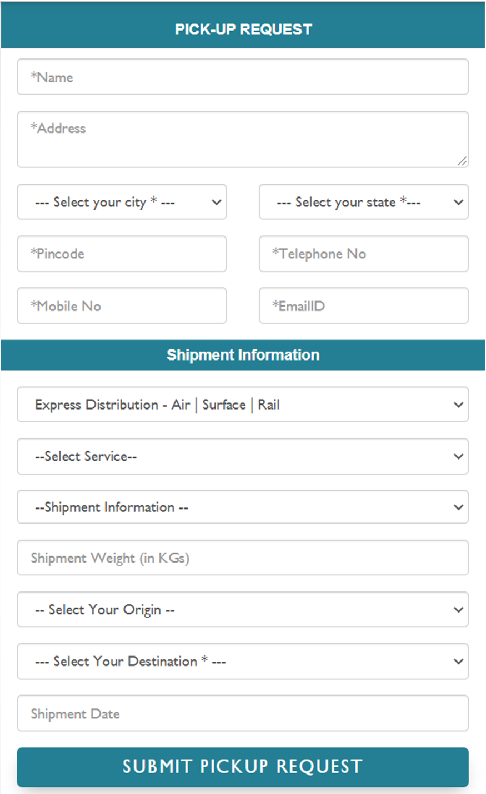
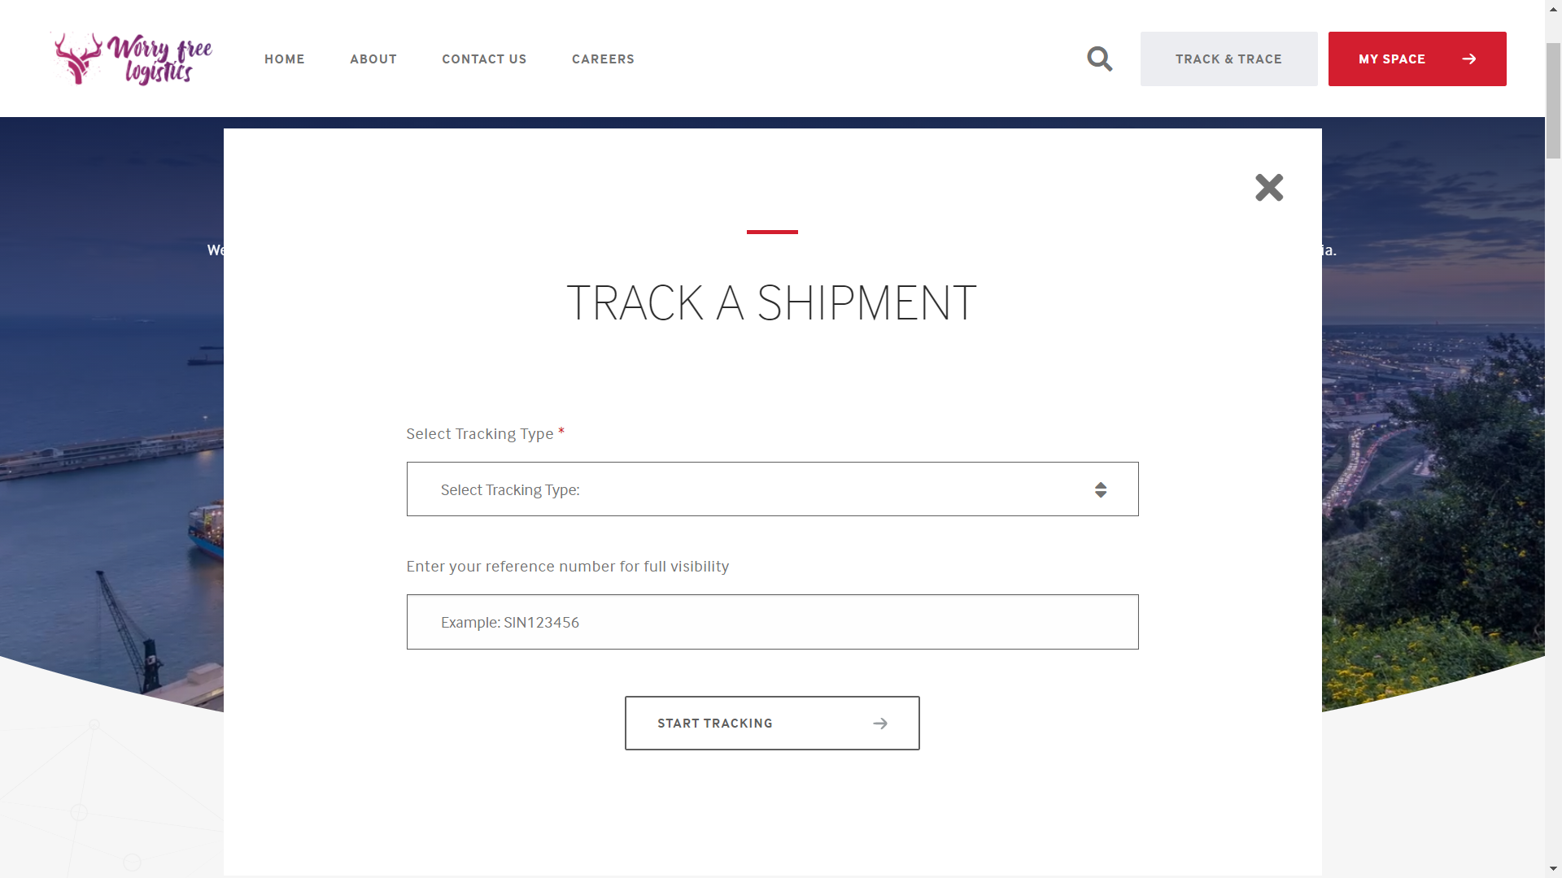
PROGRESS

Slide 20
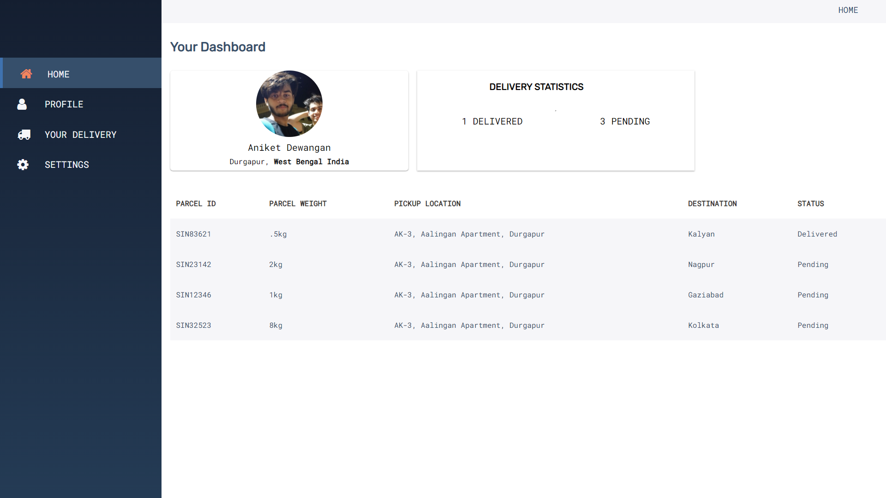
PROGRESS

Slide 21
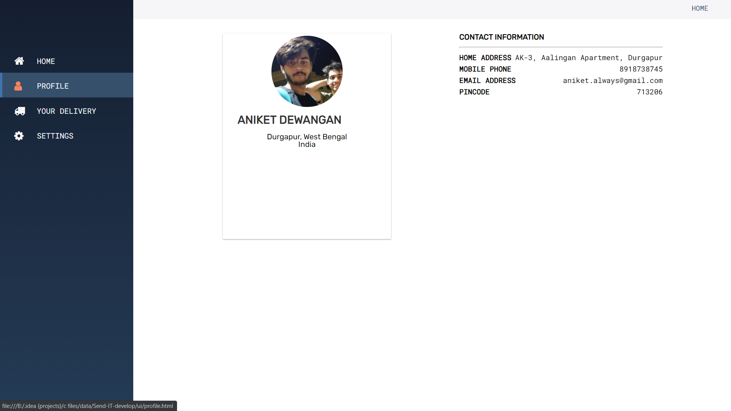
PROGRESS

Slide 22
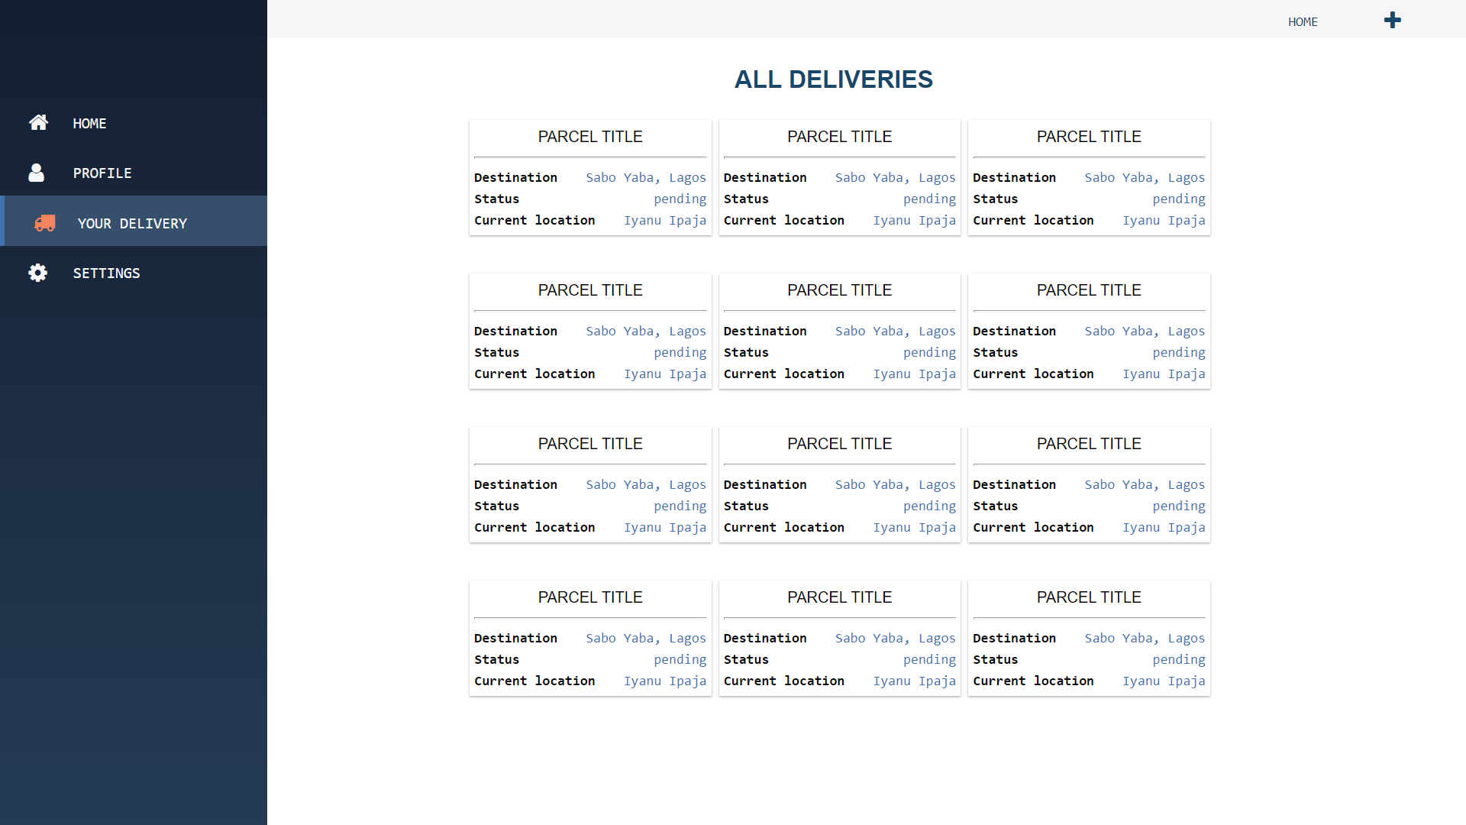
PROGRESS

Slide 23
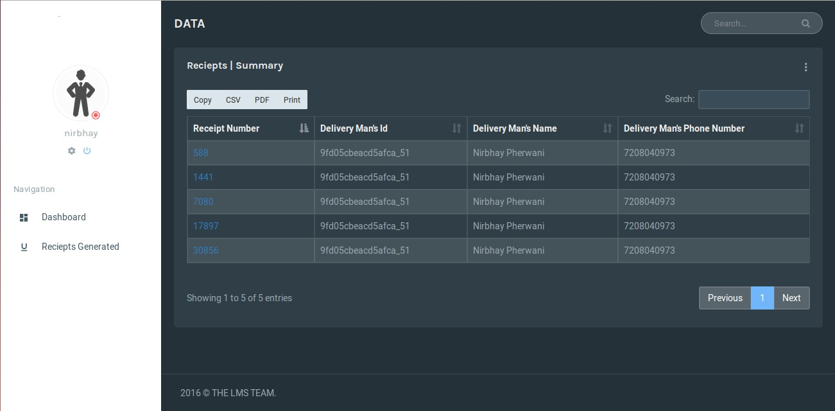
PROGRESS

Slide 24
To create a website for a logistics firm.
The website includes all features Required for a courier services.
The motto of this project is to create a platform for easier courier and logistics deliveries.
Which includes the door to door deliveries from individual as well as small business firms who wish to continue their services in this pandemic.
Including that the platform must be safe n secure and easy updations on the orders.
CONCLUSION

Slide 25
Chen Li-Li, Liu Zheng-Long, Design of Rich Client Web Architecture Based on HTML5, ICCIS, 2012
1Ch Rajesh, 2K S V Krishna Srikanth , Research on HTML in WEB Development.
Jonas Schmedtmann Why JavaScript is The Perfect Next Step After Learning HTML5 And CSS3
Tariq Rahim Soomro Node.js Challenges in Implementation.
Alkesandra Gulc , Courier Services Quality From The Clients Perspective
REFERENCES

Slide 26
THANK YOU

